Slide 1

Programming in python: selection
Lesson 2: Decisions based on calculations

Slide 2
Objectives
In this lesson, you will learn:
how to make a decision based on a calculation
how to write a program in Python that makes a decision based on the outcome of a calculation.

Slide 3
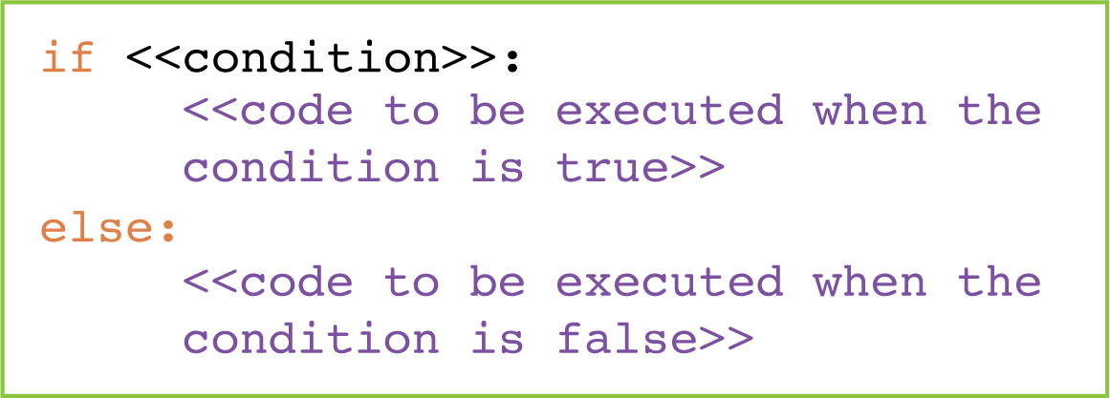
if statements
The if statement can make a decision about what to do next based on the outcome of a condition.
The condition must be a question that returns a True or False value.
It is important to understand the structure of an if statement:
An if statement must end with a colon.
The lines of code telling the computer what to do if the condition in the if statement returns True must follow the if statement and be indented.

Slide 4
Boolean operators
Here are the Boolean operators we use to create a comparison in an if statement.
Boolean operator | Meaning
> | Greater than
>= | Greater than or equal to
< | Less than
<= | Less than or equal to
== | Equal to
!= | Not equal to
What is returned by the following?
a. 5 < 7
b. 7 == 9
c. 8 != 8
d. 9 >= 9
e. 5 <= 3
They can be used to compare numeric values to perform calculations.

Slide 5

2.1: Programming in Python: selection, Section 2

Slide 6
Questions 1 and 2
How do we tell a program what to do if the condition in the if statement returns True?
How do we tell a program what to do if the condition in the if statement returns False?

Slide 7
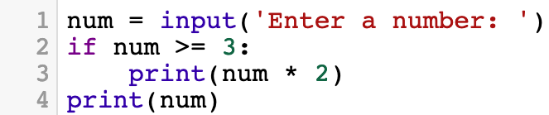
Question 3
Look at this program:
a. What is output if we input 2?
b. What is output if we input 4?
c. What is output if we input 3?

Slide 8
Quiz 2

